Slide 1
CS-440 Advanced Computer Graphics
Grandparents
Federico Stella

Slide 2
Idea

Slide 3
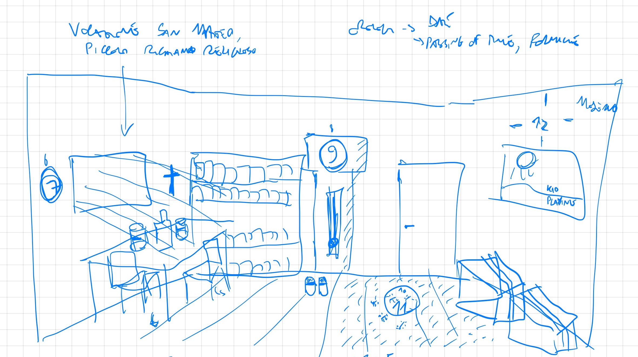
Idea

Slide 4
Idea

Slide 5
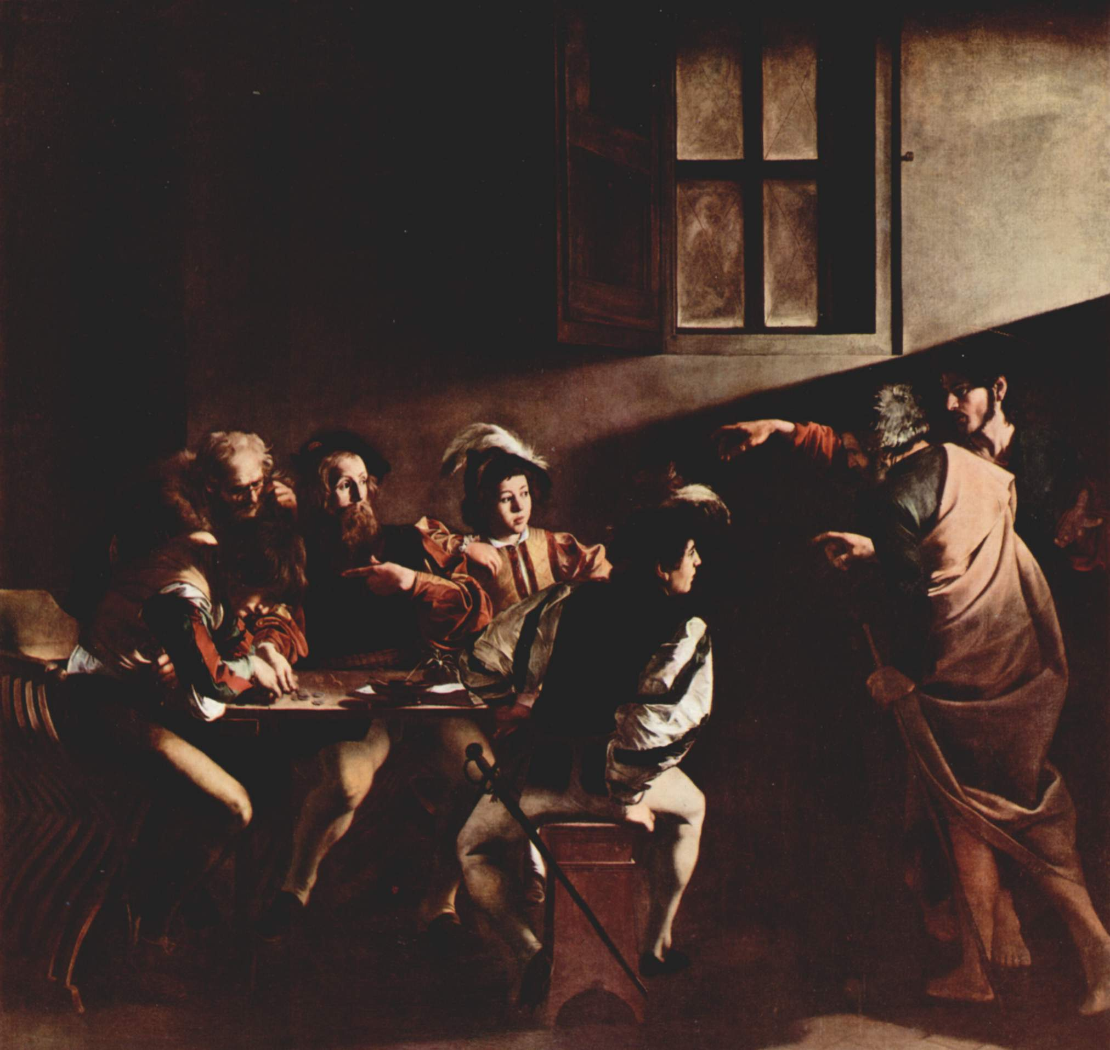
Idea

Slide 6
Idea

Slide 7
Implemented features
Materials
Rough dielectrics
Rough conductors

Slide 8
Implemented features
Materials
Rough dielectrics
Rough conductors
Surfaces
Texture mapping
Normal mapping

Slide 9
Implemented features
Materials
Rough dielectrics
Rough conductors
Surfaces
Texture mapping
Normal mapping
Lighting
Environment maps
Directional lights
Textured lights

Slide 10
Implemented features
Materials
Rough dielectrics
Rough conductors
Surfaces
Texture mapping
Normal mapping
Lighting
Environment maps
Directional lights
Textured lights
Camera
Depth of field

Slide 11
Implemented features
Materials
Rough dielectrics
Rough conductors
Surfaces
Texture mapping
Normal mapping
Lighting
Environment maps
Directional lights
Textured lights
Camera
Depth of field
Other
Incremental rendering

Slide 12
Implemented features
Materials
Rough dielectrics
Rough conductors
Surfaces
Texture mapping
Normal mapping
Lighting
Environment maps
Directional lights
Textured lights
Camera
Depth of field
Other
Incremental rendering
Final image rendered at 17mm APSC-size equivalent, 1440x810 px, 16384 samples per pixel

Slide 13
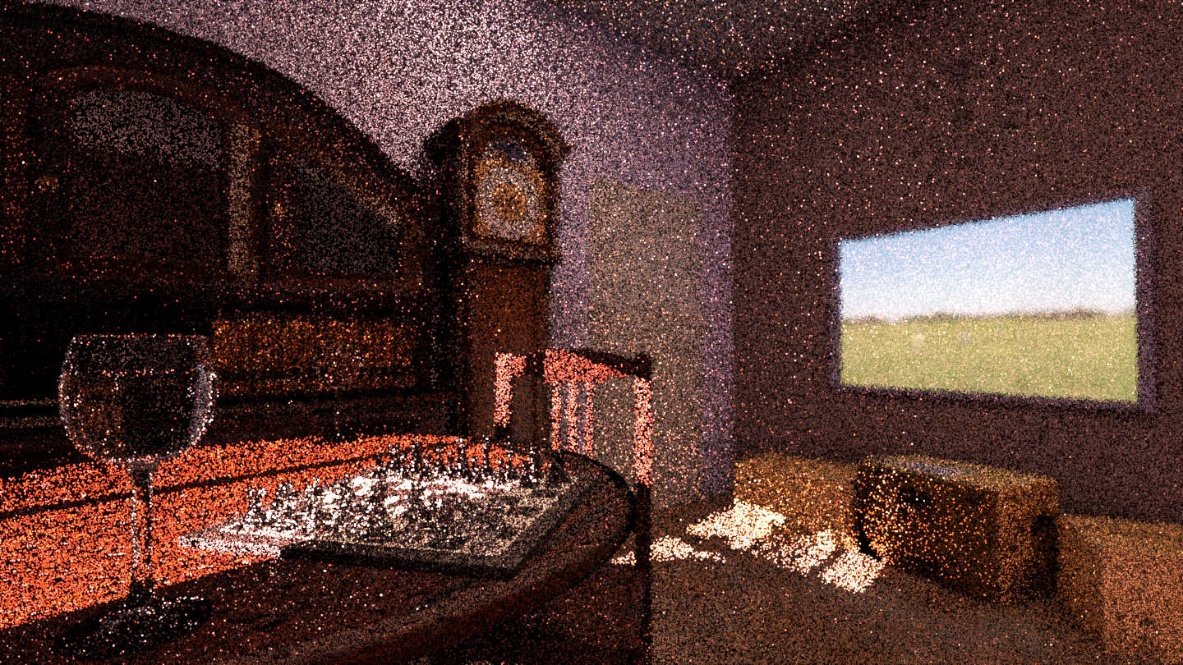
1 sample per pixel

Slide 14
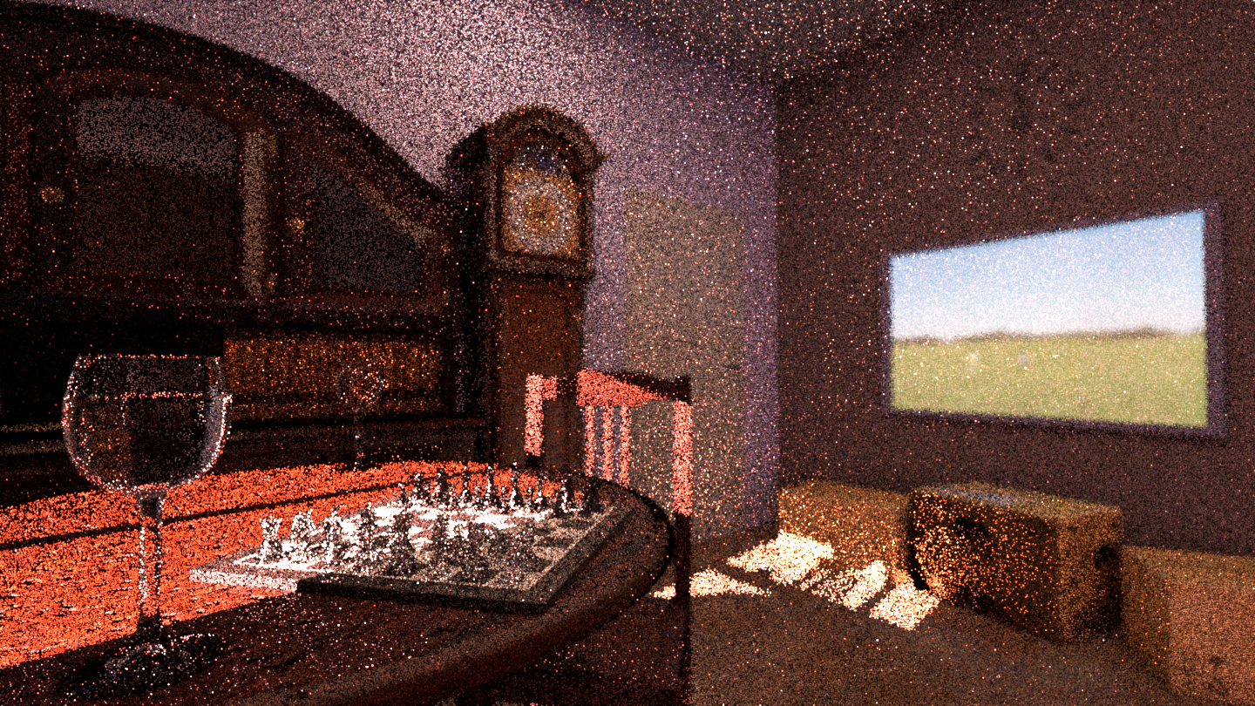
2 samples per pixel

Slide 15

4 samples per pixel

Slide 16

8 samples per pixel

Slide 17
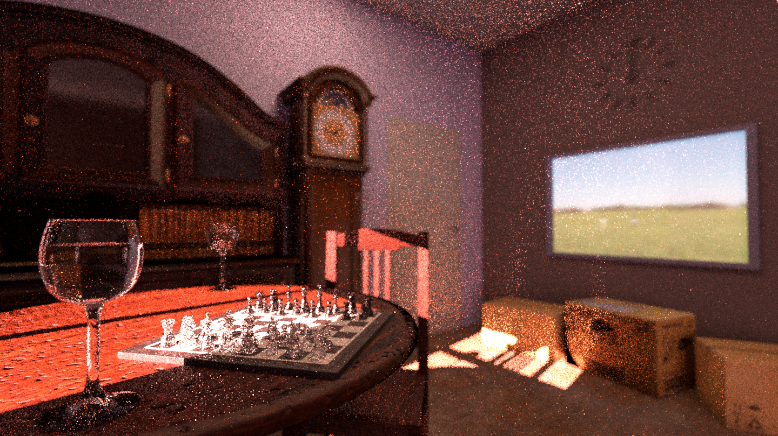
16 samples per pixel

Slide 18

32 samples per pixel

Slide 19

64 samples per pixel

Slide 20

128 samples per pixel

Slide 21
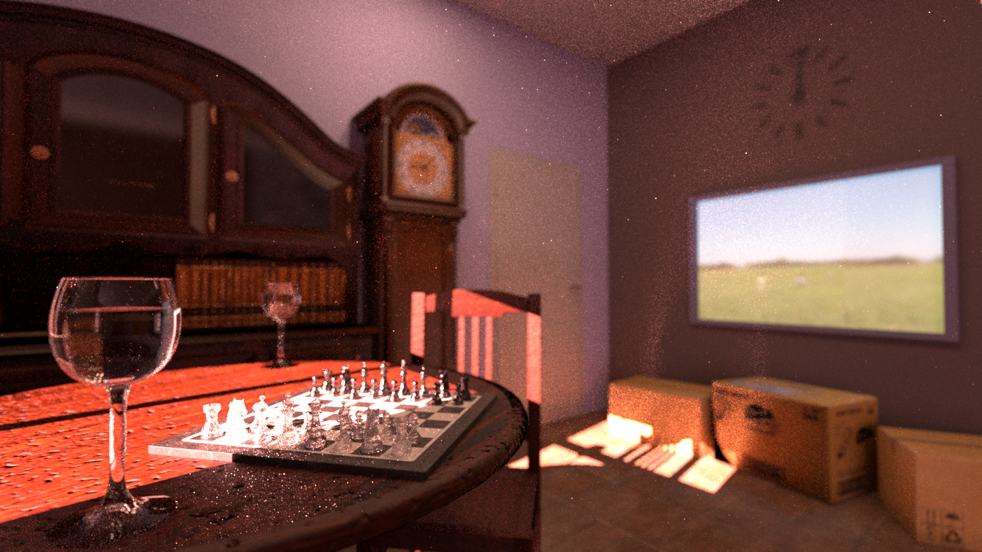
256 samples per pixel

Slide 22

512 samples per pixel

Slide 23

1024 samples per pixel

Slide 24

2048 samples per pixel

Slide 25

4096 samples per pixel

Slide 26

8192 samples per pixel

Slide 27

16384 samples per pixel – overall around 5h on M1 Pro

Slide 28
